Slide 1


Slide 2
Outline
Definition of e-commerce
Brief history of e-commerce
E-Commerce categories
Benefits of e-commerce
Business applications
Online shopping
Summary and Conclusion

Slide 3
Definition of e-commerce
E-Commerce or Electronic commerce is a process of buying, selling, transferring, or exchanging products, services, and information via electronic networks and computers.

Slide 4
Brief history of e-commerce
In 1970s
To send commercial documents like purchase orders or invoices started electronically
In 1980s
Automated taller machines(ATM)
Telephone banking
Airline reservation system

Slide 5
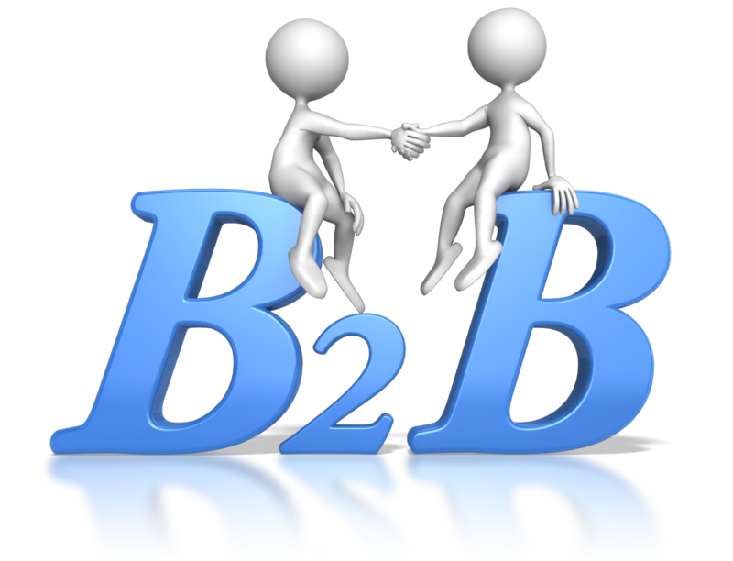

E-Commerce categories
Two Major Categories
Business-to-consumer (B2C)
Business-to-business (B2B)

Slide 6


E-Commerce categories
Other Categories
Consumer-to-consumer (C2C)
Mobile commerce (m-commerce)
E-learning

Slide 7
Benefits of e-commerce
More products and services
Cheaper products and services
Instant delivery
Information availability
Participation in auctions

Slide 8
Benefits of e-commerce
In 2000s
Many European and American business companies offered their services through the World Wide Web.
Since then, People began to associate a word “e-commerce”

Slide 9
Business applications
Email
Instant messaging
Online shopping and order tracking
Online banking
Shopping cart software
Teleconferencing
Electronic tickets

Slide 10
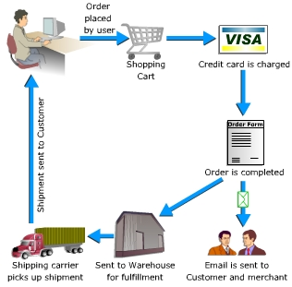
Online Shopping
How do you buy something

Slide 11
Summary and Conclusion
The Internet has lead to the birth and evolution E-commerce. E-commerce has now become a key component of many organizations in the daily running of their business.
As the Internet and in turn E-commerce has developed, and continues to evolve and grow, it is vital that any organization, in any particular industry, must base its strategic planning around such a rapidly growing medium.

Slide 12


